Slide 1
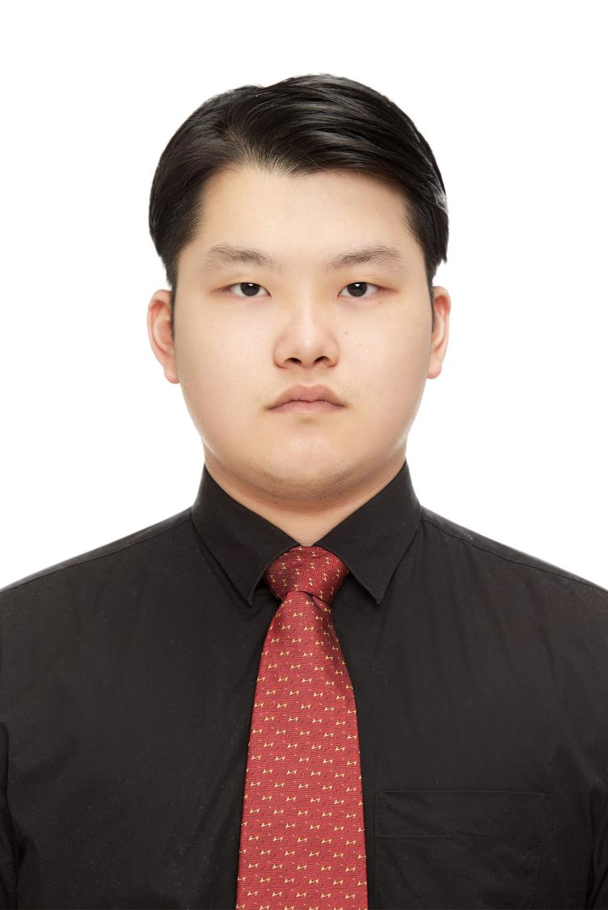
Xu JiaChen Peter
DATA Engineer team
Support GLRC smart process

Slide 2

About me
Nationality: Chinese
City of birth：Shanghai
Language：CHINESE ENGLISH

Slide 3


Education
Bachelor of Engineering
Shanghai University of Electric Power
2014-2018
Major：Software Engineering

Slide 4

experience
Tech Skill
IOT Android
DevOps
Python Full Stuck
Java Backend
C51
Robot
J2EE
Spring
2014-2018
University Robot Lab Leader
C51 STC Embedded development
Freelance developer
Java Backend | J2EE Spring MVC
Android IOT

Slide 5
experience
Tech Skill
IOT Android
DevOps
Python Full Stuck
Java Backend
Python
Docker
Node.js
Jenkins
2017-2019
Python Full Stuck
Python Node.js Redis MySQL Linux
DevOps
Building Dashboard | HTML CSS JS
Docker Jenkins CI/CD

Slide 6

About me

Slide 7


Education
Master of Technology
National University of Singapore
Institute of Systems Science
2019-2020
Major：Intelligent System

Slide 8


experience
Tech Skill
NLP
Data Engineer
AI + Full Stuck
Python
Docker
PyTorch
NLP
2019-2020
Studying for Master
Al + Full Stuck NLP
2020.02 – 2020.05
Neural Machine Translation
A Star I2R

Slide 9


experience
Tech Skill
NLP
Data Engineer
AI + Full Stuck
Learning...
Present
OCBC Bank GCAD
Data Engineer

Slide 10
Hobby
Cooking & baking

Slide 11
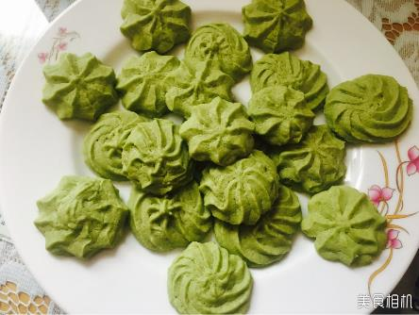
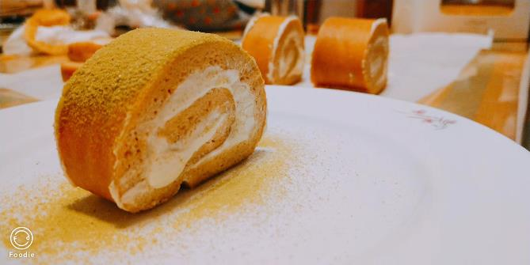
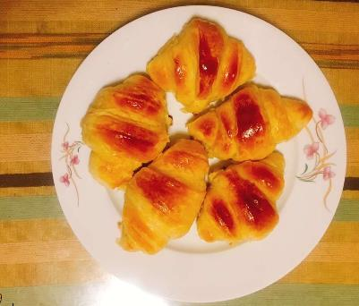
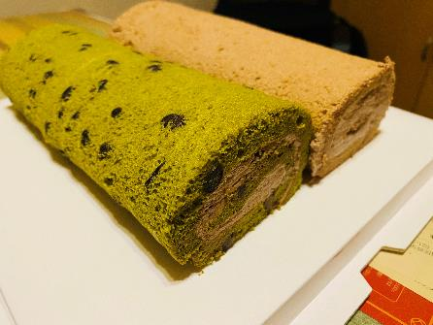
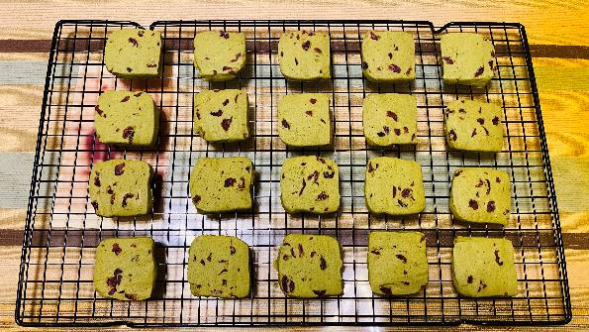
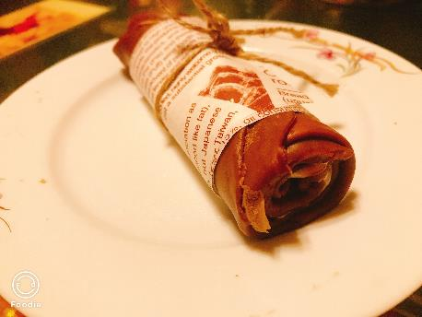
Hobby
bakinG

Slide 12
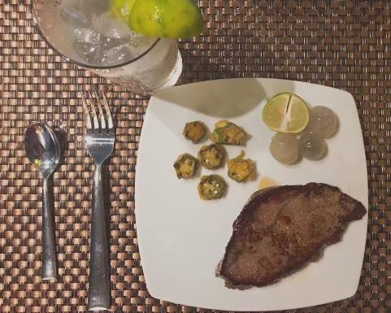
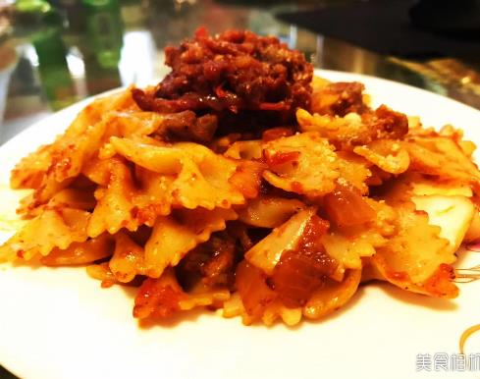
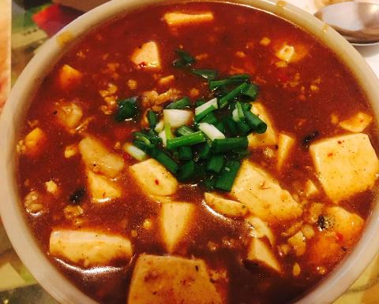
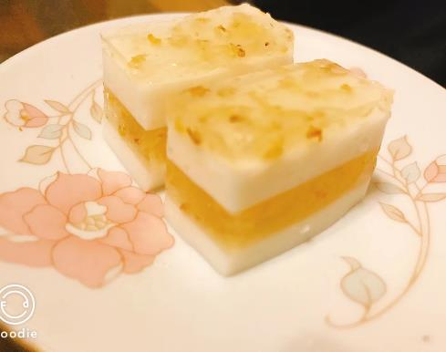
Hobby
Cooking

Slide 13
Hobby
traveling

Slide 14


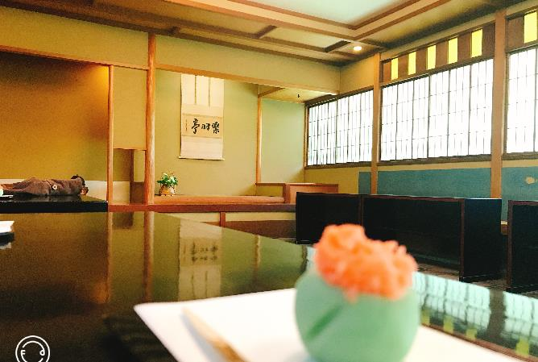
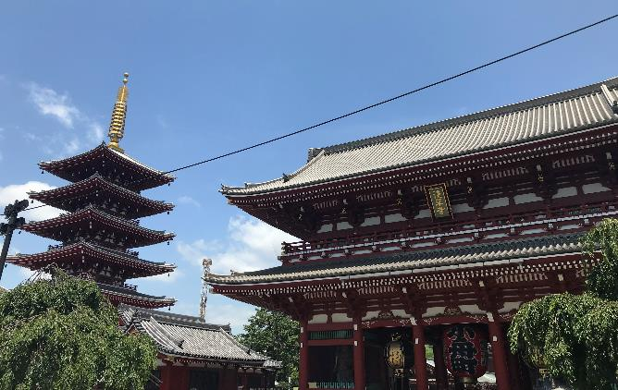
Hobby
Traveling -- Tokyo

Slide 15
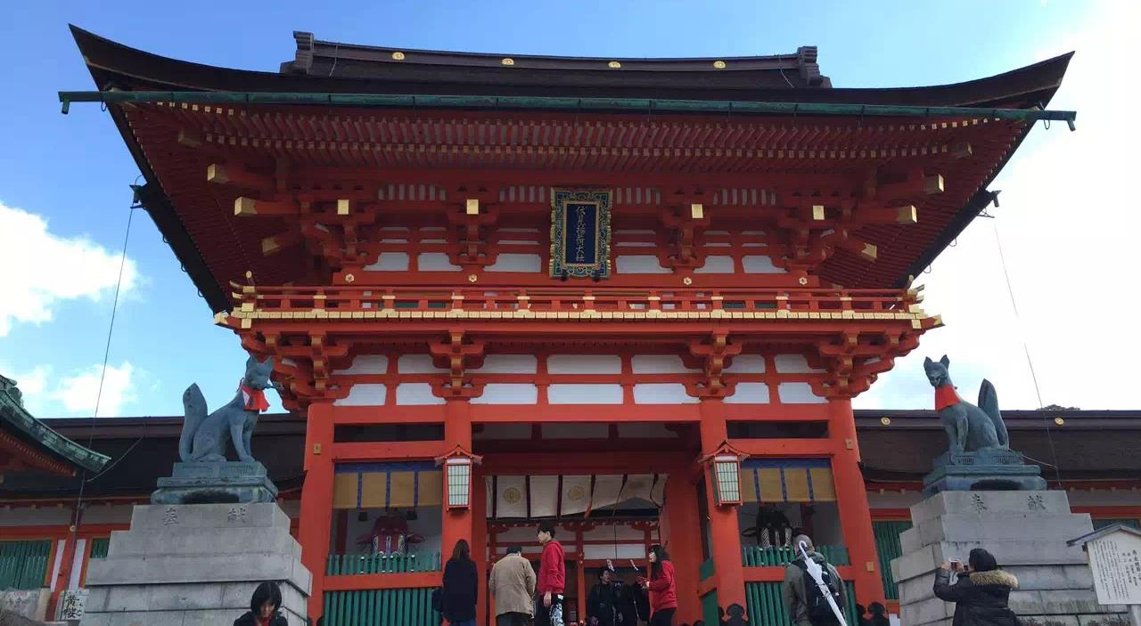

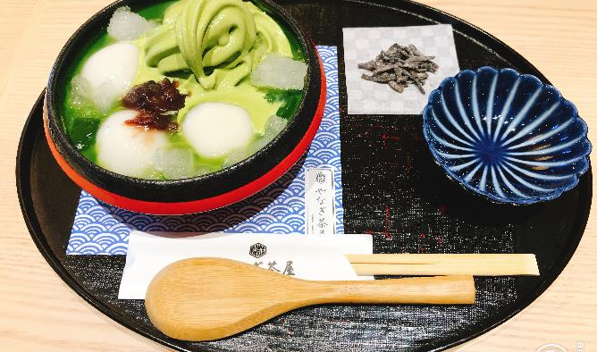
Hobby
Traveling -- Osaka

Slide 16
THANK YOU

